Slide 1

CMR COLLEGE OF ENGINEERING & TECHNOLOGY
Kandlakoya, Medchal, Hyderabad - 501401
Department of Computer Science and Engineering
SEREVERLESS WEBSITE ON AWS
Batch No : 39
Name of the student:
20H51A05G8-G.Harshavardhan Reddy
20H51A05H0-G.Supriya
20H51A05L1-M.Srikanth
Under esteemed guidance of
Guide Name: Dr.G.Ravi Kumar

Slide 2
Outline
Abstract
Introduction
Research Objective
Problem Definition
Scope of the Project
Research work
- Proposed Methodologies
- System Architecture
- Comparison of Proposed system with an existed system
Results
Conclusion
Future Work
References
Notes:
2

Slide 3
Abstract
Notes:
3

Slide 4
ABSTRACT
Serverless computing has gained significant popularity recently due to its ability to simplify application development and deployment processes. In this context, AWS (Amazon Web Services) offers a comprehensive set of services that enable the creation and hosting of serverless websites.
AWS offers several services that facilitate the creation of serverless websites. AWS Lambda, a serverless computing service, allows developers to run their code in response to events without the need to provision or manage servers. It supports multiple programming languages and automatically scales based on the incoming traffic.
This abstract focuses on the concept of a serverless website using AWS. The traditional model of hosting websites typically involves managing and provisioning servers, configuring web servers, and handling scalability challenges. However, with serverless architecture, developers can focus on writing code without worrying about server management.
For front-end development, AWS provides Amazon S3 (Simple Storage Service), a scalable storage solution that allows the hosting of static website content. Amazon CloudFront, a content delivery network (CDN), can be utilized to improve website performance by caching content globally.

Slide 5
INTRODUCTION
Notes:
5

Slide 6
Introduction
In recent years, serverless computing has revolutionized the way applications are developed and deployed. Traditional website hosting models require managing servers, configuring web servers, and dealing with scalability challenges. However, with the advent of serverless architecture, developers can now focus on writing code without worrying about server management and infrastructure complexities.
A serverless website built on AWS leverages the power of cloud computing to handle the underlying infrastructure. Instead of provisioning and managing servers, developers can concentrate on writing application logic and deploying code. This paradigm shift allows for faster development cycles, improved scalability, and reduced operational overhead.
At the heart of a serverless website on AWS is AWS Lambda, a serverless computing service. Lambda enables developers to run code in response to events or triggers, without the need for managing servers or infrastructure. It supports multiple programming languages, making it accessible to a wide range of developers.
Notes:
6

Slide 7
Research Objective
Notes:
7

Slide 8
Research objective
Understanding the concepts of serverless architecture: The research should delve into the fundamentals of serverless computing, including its benefits, limitations, and key principles. It should explain how serverless architecture differs from traditional hosting models and highlight the advantages it brings to website development.
Exploring AWS serverless services: The research should provide a comprehensive overview of the AWS services specifically designed for serverless web development. This includes understanding the capabilities and use cases of AWS Lambda, Amazon S3, CloudFront, API Gateway, and database services like DynamoDB and Aurora Serverless. It should cover topics such as how to create, deploy, and integrate these services within a serverless website architecture.
Scalability and performance considerations: The research should address scalability challenges and performance optimization techniques in serverless web applications. It should explore strategies for handling high-traffic loads, managing concurrent executions, and optimizing response times. This can include examining features like auto-scaling, caching, and load balancing provided by AWS services.

Slide 9
Problem Definition
Notes:
9

Slide 10
Problem Definition
The traditional model of website hosting and development involves managing servers, configuring web servers, and dealing with scalability challenges. This process can be time-consuming, resource-intensive, and complex, requiring expertise in server management and infrastructure provisioning. Additionally, scaling websites to handle fluctuating traffic can be a challenging task.
Server Management Complexity, Scalability and Performance. Cost Inefficiency.

Slide 11
Scope of the Project
Notes:
11

Slide 12
Scope of the Project
The scope of building a serverless website using AWS encompasses various aspects of development, deployment, and management. The project scope includes:
Architecture Design: Defining the architecture and components of the serverless website, including the selection of AWS services such as AWS Lambda, Amazon S3, CloudFront, API Gateway, and relevant database services. The architecture design should consider scalability, performance, security, and cost optimization.
Front-end Development: Developing the front-end components of the website using HTML, CSS, and JavaScript frameworks. This includes creating responsive web pages, integrating with AWS S3 for hosting static assets and utilizing CDN services like CloudFront for content delivery.
Backend Development: Writing serverless functions using AWS Lambda to handle dynamic functionality and business logic. This involves choosing the appropriate programming language, setting up Lambda functions, and integrating them with other AWS services like API Gateway and databases.

Slide 13
Research Work
Notes:
13

Slide 14
Proposed Methodologies
Requirements Gathering: Begin by gathering and documenting the functional and non-functional requirements for the serverless website. This includes understanding the target audience, desired features, performance expectations, scalability requirements, and security considerations.
Architecture Design: Design the serverless website architecture using AWS services. Determine the components needed, such as AWS Lambda for serverless functions, Amazon S3 for hosting static assets, CloudFront for content delivery, API Gateway for API management, and relevant database services like DynamoDB or Aurora Serverless. Consider scalability, performance, security, and cost optimization aspects during the architecture design phase.
Front-end Development: Develop the front-end components of the website using HTML, CSS, and JavaScript frameworks. Implement responsive web design principles and ensure compatibility across various devices and browsers. Host the static assets on AWS S3 and utilize CloudFront for content distribution and caching.

Slide 15
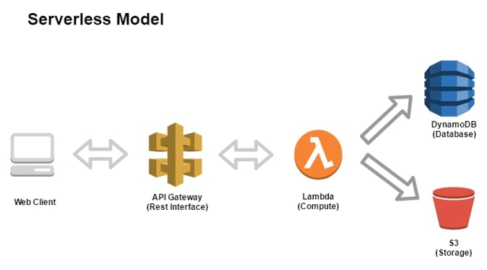
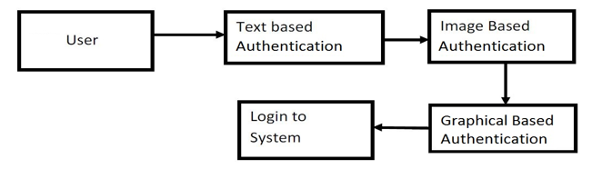
System Architecture

Slide 16
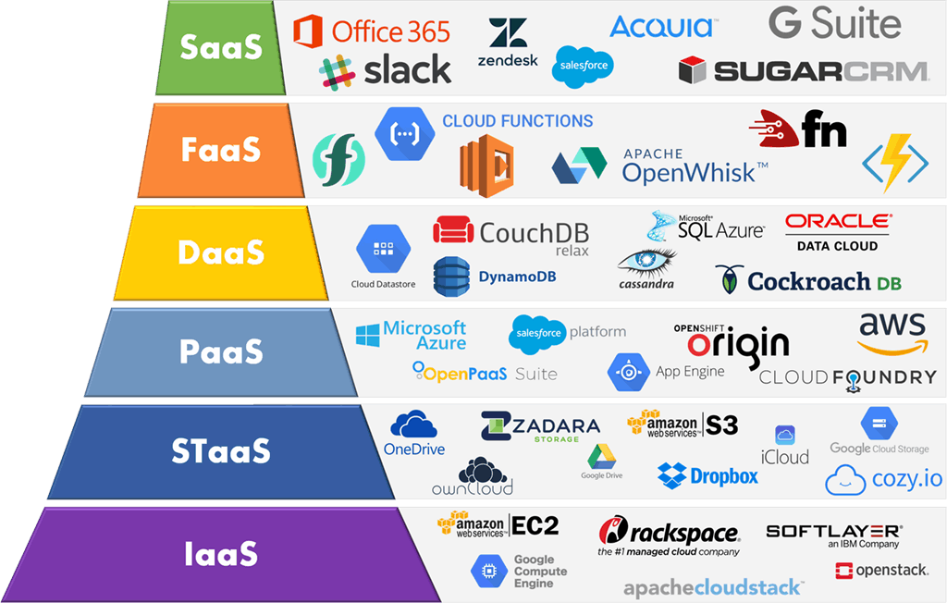

Slide 17
Comparison of Proposed system with an existed system
The proposed system of building a serverless website using AWS offers several advantages and improvements compared to traditional hosting models or existing systems. Here is a comparison highlighting the benefits of the proposed system:
Simplified Server Management:
Proposed System: The proposed system eliminates the need for server management as AWS takes care of infrastructure provisioning, scaling, and maintenance.
Existing System: In traditional hosting models, server management requires manual configuration, updates, and monitoring, which adds complexity and overhead.
Scalability and Performance:
Proposed System: The proposed system leverages AWS services like AWS Lambda and auto-scaling capabilities, enabling automatic scaling based on demand. This ensures optimal performance even during high-traffic periods.
Existing System: Scaling in existing systems often requires manual intervention and provisioning of additional servers, which can be time-consuming and may result in performance issues or downtime.
Notes:
Simplified Server Management:
Proposed System: The proposed system eliminates the need for server management as AWS takes care of infrastructure provisioning, scaling, and maintenance.
Existing System: In traditional hosting models, server management requires manual configuration, updates, and monitoring, which adds complexity and overhead.
Scalability and Performance:
Proposed System: The proposed system leverages AWS services like AWS Lambda and auto-scaling capabilities, enabling automatic scaling based on demand. This ensures optimal performance even during high traffic periods.
Existing System: Scaling in existing systems often requires manual intervention and provisioning of additional servers, which can be time-consuming and may result in performance issues or downtime.

Slide 18
Result Analysis
Analyzing the results of building a serverless website using AWS involves assessing the success of the project based on predefined metrics and goals
Performance: Evaluate the performance of the serverless website by measuring factors like response time, throughput, and latency. Compare the performance against defined performance targets and assess whether the website meets or exceeds expectations. Use tools like AWS CloudWatch or third-party monitoring services to gather performance data.
Scalability: Measure the scalability of the serverless website by examining its ability to handle increasing traffic and concurrent user requests. Monitor the auto-scaling behavior of AWS Lambda functions and other AWS services to ensure they scale up and down based on demand. Verify that the website performs well under peak load conditions and can accommodate growth without performance degradation.
Cost Optimization: Assess the cost optimization achieved through the serverless architecture. Compare the actual costs incurred with the estimated costs and traditional hosting models. Analyze the cost savings achieved by paying only for the resources consumed and the elimination of upfront infrastructure investments. Consider factors like AWS Lambda pricing, data transfer costs, and usage patterns to determine the cost-effectiveness of the serverless website.

Slide 19
Conclusion
In conclusion, building a serverless website using AWS offers numerous advantages over traditional hosting models. By leveraging AWS services like AWS Lambda, Amazon S3, API Gateway, and others, developers can create highly scalable, cost-efficient, and easily manageable websites. The serverless architecture eliminates the need for server management, allowing developers to focus on coding and accelerating development cycles. Throughout the project, the proposed methodologies guide the development process, covering requirements gathering, architecture design, front-end and back-end development, database integration, API development, deployment, security, testing, and documentation. These methodologies ensure a systematic and efficient approach to building a serverless website.

Slide 20
Future work
Future Work for a Serverless Website Using AWS:
Enhancing Functionality: Continuously work on adding new features and functionalities to the serverless website based on user feedback and evolving requirements. Explore additional AWS services that can be integrated, such as Amazon Cognito for user authentication or AWS Step Functions for building serverless workflows.
Optimizing Performance: Monitor and analyze the performance of the serverless website to identify areas for optimization. Implement performance tuning techniques, leverage caching mechanisms, and explore AWS services like AWS Elasticache for further performance improvements. Conduct load testing to validate the website's performance under heavy traffic conditions.
Advanced Security Measures: Strengthen the security of the serverless website by implementing advanced security measures. Consider using AWS Web Application Firewall (WAF) for protection against common web exploits and DDoS attacks. Implement additional encryption methods, such as AWS Key Management Service (KMS) for managing encryption keys.

Slide 21
References
1. https://amonkincloud.com/
2. https://docs.aws.amazon.com/serverless-application-model/latest/developerguide/what-is-sam.html
3. https://amonkincloud.com/
4. https://docs.aws.amazon.com/serverless-application-model/latest/developerguide/what-is-sam.html
5. https://docs.aws.amazon.com/lambda/latest/dg/welcome.html

Slide 22
Thank You!

